Slide 1
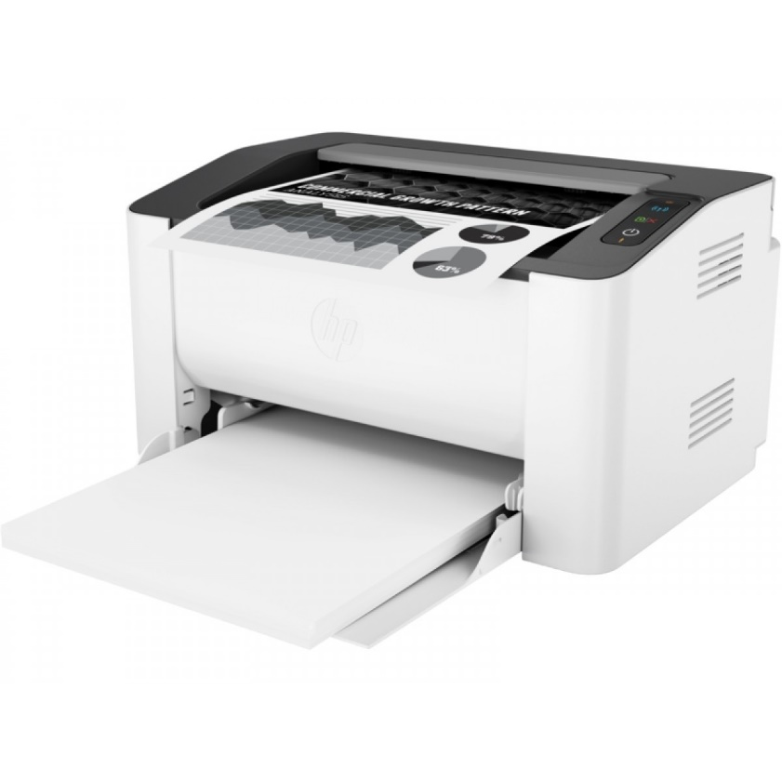
Term 2 – ICT –Week 6 Printing and Capturing Evidence
ICT CLASS
Professor. A. Lawson
Class objectives and overview:
Student to know different names of printers
Understand how each printer is used and how
How printing changed out society and the benefits of printing
How to capture images and edit them (screen shot)

Slide 2
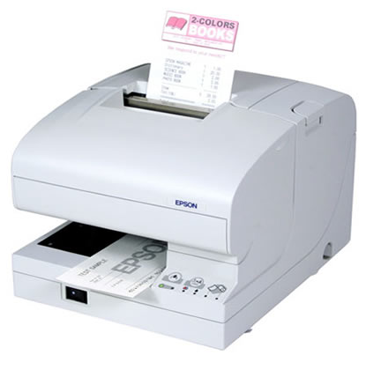
Task of the day
Your are to find 5 different types of printers that exist and write their names and how they print.
Dot Matrix printers used to print out receipts in stores and lotto tickets
EXAMPLE - 1
These printers are used to print quick receipts at stores and are quite noisy when they do so used from ink printing
Printer names and do they use ink or plastic or photo
What are the sizes of there printers
How quick do they print
What are the costs of these printers
Who usually has these types of printers
EXAMPLES
Also include in your task
Screen shot evidence – what's is meant by PrtScn (button) or the Snip tool in some cases as well. Use them when creating this Power Point

