Slide 1
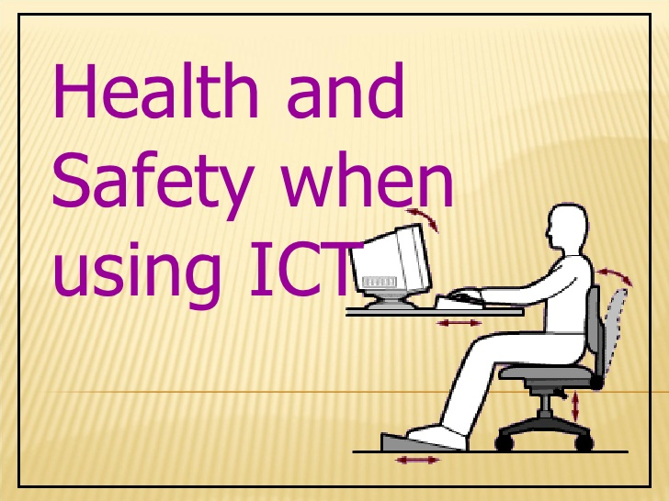
Term 2 – ICT –Week 5 Health and safety when working with computers
ICT CLASS
Professor. A. Lawson
Class objectives and overview:
Student to understand the safety measures around computers
Learn new vocabulary words related to safety
Be more aware of how to be safe when using technology in daily lives

Slide 2
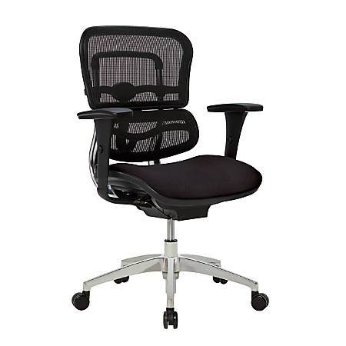
Task of the day
Your are to find 5 things that have health and safety importance when using computers
Use ergonomics chairs to assist the equipment design process.
EXAMPLE - 1
These special chairs help with back pain and posture specially when working in front of computers for long periods of time.
provide tiltable screens
provide anti-glare screen filters
provide adjustable chairs
provide foot supports
make sure lighting is suitable
make sure workstations are not cramped
plan work at a computer so that there are frequent breaks
pay for appropriate eye and eyesight tests by an optician
EXAMPLES

