Slide 1
Term 2 – ICT –Week 2 File Management & Settings
A. Lawson

Slide 2
What does it mean? Definitions.
File management:
Is the process of administering a system that correctly handles digital data.
Computer Settings
A software control panel that enables the you the user to configure or change the appearance or actions in an application, operating system or the hardware.

Slide 3
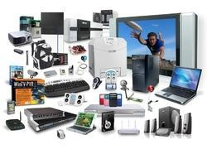
TASK 1 - Computerized Systems
A computerized system includes: the computer hardware, computer software, peripheral devices, personnel, and computer system documentation (including computer hardware and software manuals, specifications for peripheral devices and standard operating procedures).
Name 5 computerized systems and explain how they work

Slide 4
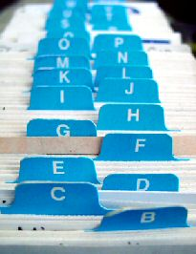
TASK 2 – Manual Paper Based Systems
Manual paper-based system:
used to describe a system that keeps information on paper, rather than on a computer: It costs them about $65 to process a paper-based order. made of paper: People who sell paper-based products are facing rising costs.
What is the advantage and disadvantages of having a paper based system over computerized

