Slide 1
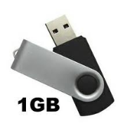
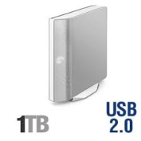
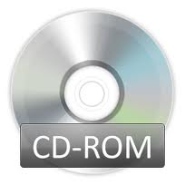
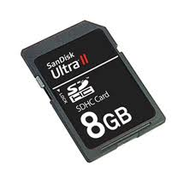
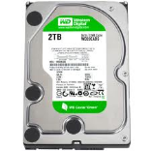
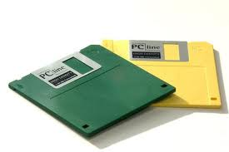
Chapter 3 – Storage Devices and Media Types of Backing Storage
Task 1: Put the different backing storages into order (smallest capacity to the biggest). Write the capacity and use for each backing storage.
Type |  | Use
1 |  | Name: Floppy Disk Capacity:1.4 mb Use:
2 |  | Name: Capacity: Use:
3 |  | Name: Capacity: Use:
4 |  | Name: Capacity: Use:
Type |  | Use
5 |  | Name: Capacity: Use:
6 |  | Name: Capacity: Use:
7 |  | Name: Capacity: Use:
8 |  | Name: Capacity: Use:

Slide 2
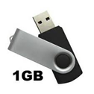
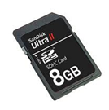
Task 2 – Backing up of Data | 15 minutes
Answer the questions based on backing up Data
What is backing up of data?
Why back up data?
Type | Advantages | Disadvantages
USB
Type | Advantages | Disadvantages

