Slide 1
Identify storage devices, their associated media and their uses, e.g. Magnetic backing storage media: fixed hard disks and drives, portable and removable hard disks, portable and removable hard drives, magnetic tape drives and magnetic tapes, memory cards Optical backing storage media (CD/DVD/Blu-ray): CD ROM/DVD ROM, CD R/DVD R, CD RW/DVD RW, DVD RAM, Blu-ray discs Solid state backing storage: solid state drives, flash drives (pen drive/memory stick/USB stick)
Describe the advantages and disadvantages of the above devices

Slide 2
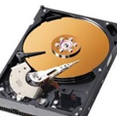
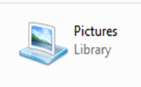
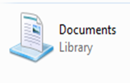
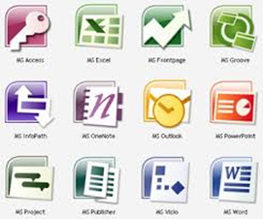
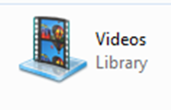
What is Storage
Secondary Storage devices ensures data is stored permanently so that it can be used again at a later date.
Storage medium is the name given to the device that actually holds the data.
Sometimes the storage medium is fixed i.e. magnetic coated disks build into hard drive.
Sometimes the storage medium is removable from the device i.e. CD ROM that can be taken out of the drive.
Think about what we store:
Documents, Images, Video, Music, Software, Games etc.

Slide 3
File Sizes
Storage devices or files sizes are measured in:
Kilobytes (KB), Megabytes (MB), Gigabytes (GB) and Terabytes (TB)
1 KB
1000 Bytes
* 1000
1 MB
1000 KB
* 1000
1 GB
1000 MB
* 1000
1 TB
1000 GB
Diagram not to scale

Slide 4
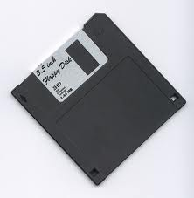
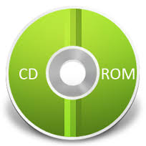
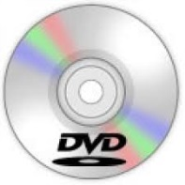
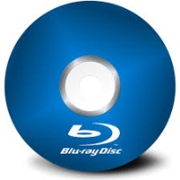
Data Storage Capacity
Floppy Disk 1.4MB
Data storage devices have very different capacities. Over time the capacity has increased which has allowed for more data to be stored:
CD-ROM
700MB
DVD
4.7GB
Blu-Ray
25 GB – 128GB
Increase in storage capacity
Hard Drive
8 TB
Magnetic Tape
Up to 185 TB

Slide 5
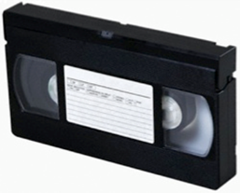
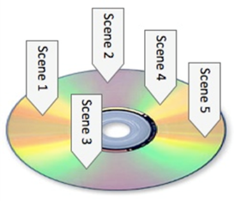
Type of Access
Serial (sequential Access)
 | Files are stored one by one in a sequence Must search through the files one by one until you get to the one you want. Example: VHS tape, Cassette Tape, Magnetic Tape
Start 1 | 2 | 3 | 4 | 5 | 6 | 7 | 8 | 9 | End 10
Direct (Random Access)
 | Stores files so that they can instantly be accessed No need to search through files to get to the one you want Example: DVD, CD ROM, Blu-ray, external hard drive, flash drive
Start 1 | 2 | 3 | 4 | 5 | 6 | 7 | 8 | 9 | End 10

Slide 6
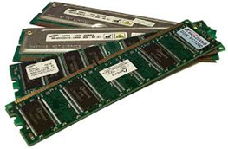
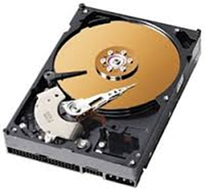
Main Memory Vs Backing Storage
Main Memory
 | Sometimes known as Internal Memory or primary memory. Includes RAM and ROM Usually used to store data temporarily (in the case of RAM). Usually used to store data while it is being processed by the CPU. Is volatile – means data will be lost if computer is turned of.
Backing Storage
 | Backing storage some known as secondary storage. Name for all other storage devices which are part of a computer like hard drive. Usually used to store data over a long time. Usually used to store application software, operating system software, files etc. Is Non-volatile - Means data will not be lost of computer is turned off.

Slide 7
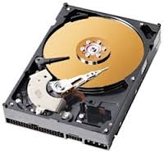
Fixed Internal Hard Drive
Magnetic Storage Devices
Use: | Main backing storage device used by all computers to store: Operating Systems & System Files Applications Files (Documents, Images, videos, audio etc.)
Access Type: Direct (Random Access)
Advantages: | Disadvantages
Less likely to break as fixed. High storage capacities compared to external drives. Fast data transfer rate. | More moving parts compared to solid state drives. Incorrect shut down procedure could cause hard drive to malfunction.
Magnetic storage media devices store data in the form of tiny magnetised dots. These dots are created, read and erased using magnetic fields created by very tiny electromagnets.

Slide 8
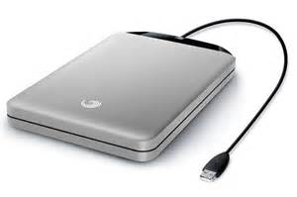
Portable Hard Drive
Magnetic Storage Devices
Use: | This device connects to the computer using the USB Port. External Hard drives are used to store: Personal backup data. Transfer files between computers/devices
Access Type: Direct (Random Access)
Advantages: | Disadvantages
Portable – transfer files between computers. High Storage capacity compared to optical disks. | More prone to errors than fixed hard drive. Could be damaged if incorrectly ejected from computer.
Magnetic storage media devices store data in the form of tiny magnetised dots. These dots are created, read and erased using magnetic fields created by very tiny electromagnets.

Slide 9
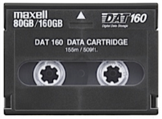
Magnetic Tapes
Magnetic Storage Devices
Use: | Large organisations make daily backups of their networks on to Magnetic Tapes Long-term archiving of data.
Access Type: Serial
Advantages: | Disadvantages
Huge storage capacity compared to fixed and portable hard drives. Stored away in a fire proof safe. Robust – last for long time | Slower Access Tape reader has to start at the beginning of the tape and continue fast forwarding until it gets to the piece of data that needed.
Magnetic storage media devices store data in the form of tiny magnetised dots. These dots are created, read and erased using magnetic fields created by very tiny electromagnets.

Slide 10
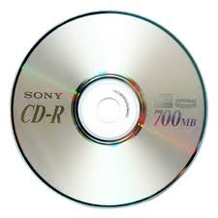
CD-ROM
Optical Media
Use: | CD-ROM disks are read-only. CD-ROMs are normally used to store: Audio CDs Software Applications Device Drivers
Optical storage devices save data as patterns or dots.
Data is read by bouncing the laser beam off the surface off the medium.
Access Type: Direct
Advantages: | Disadvantages
Hold more data than floppy disks. Cheaper than hard drives and USBs. Compatible with audio systems. | Data transfer rate is slower compared to other storage medium. Not Robust - easily be damaged or scratched.

Slide 11
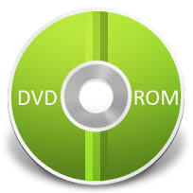
DVD-Rom
Optical Media
Use: | DVD-ROMs disks are read-only. DVD-ROMs are normally used to store: DVD Movies Software Applications Computer Games
Optical storage devices save data as patterns or dots.
Data is read by bouncing the laser beam off the surface off the medium.
Access Type: Direct
Advantages: | Disadvantages
Hold more data than CD-ROMS. Can store larger applications. Videos is higher resolutions. | Data transfer rate is slower compared to other storage medium. Have to buy a separate DVD player.

Slide 12
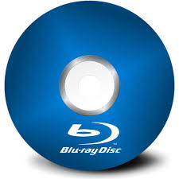
Blu-Ray
Optical Media
Use: | Blu-Ray disks uses a blue laser instead of red laser used with CD/DVD ROMs. Blu-Ray disks are normally used to stored: HD Movies Large Software/Game Applications In camcorders in cartridge form.
Optical storage devices save data as patterns or dots.
Data is read by bouncing the laser beam off the surface off the medium.
Access Type: Direct
Advantages: | Disadvantages
Large storage capacity used to store HD video content. Access Speeds are greater than other optical medium. Secure Encryption System to minimise chance of copyright. | More expensive compared to other optical media. Separate player required – more expensive. Not all movie titles available on Blu-Ray.

Slide 13
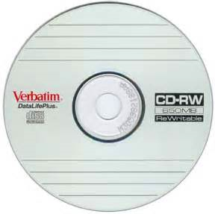
Optical Media
R – Write once only
RW – Can be written to or read many times.
 | CD-R and DVD-R | CD-RW and DVD-RW) | DVD RAM
Overview | CD-R and DVD-R are only recordable once. Once the process has been finalised then the disks become Read Only. Backup of data Audio CDS | CD-RW and DVD-RW allows for data to be written, erased and rewritten many times. Used in CCTV Record television programs | DVD RAMS are used when data constantly needs to be re-written. DVD RAMS can hold up to 10GB of data and commonly used in recording equipment.
Advantages | Cheaper than RW disks. | Can be reused many times. | Long life, large capacity, and can be rewritten many times.
Disadvantages | Not compatible with all players. If disk has a burn error it can not be used again. | Can be expensive. Data could be overwritten. | Not compatible with all playback formats. Can be expensive.

Slide 14
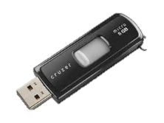
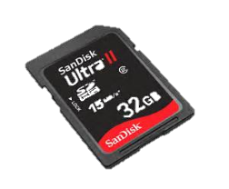
Solid ‘state’
Solid-state storage devices are based on electronic circuits with no moving parts. Solid-state storage devices store data using a special type of memory called flash memory. USB/Memory Cards use Direct Access
Examples | USB Memory Stick | Memory Card
Uses: | Used to transfer files/backup (work) between computers. | Used to store files on digital cameras, mobile phones and mp3 players.
Advantages | Portable & Small Robust large capacities No need for additional drivers/software | Very small and can be removed and placed in other devices. Robust
Disadvantages | Easy to loose USB could be damaged if not ejected correctly. | Smaller storage capacities. Quite expensive.

Slide 15
Backup
Backup means making one or more copies of your data in a different storage medium.
Why?
You could delete a file by accident
Your computer could break down
Your computer could get infected by a virus which could edit data
Your laptop is stolen or becomes damaged.
Data could be corrupted by hackers.
Most businesses use computers to store very important data (customer records, financial information, designs for products, etc.)
If this data is lost, then this would cause disruption to the business. Backing-up business data is essential.

Slide 16
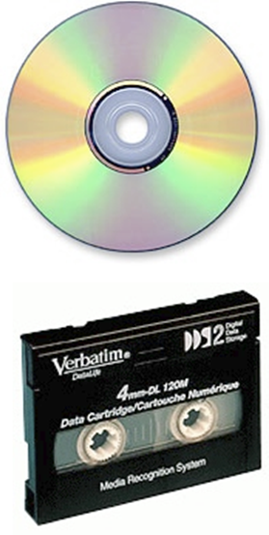
How are Backups created
Personal Backups:
Burning files to a CD-R
Copying files to an external hard-drive
Copying files to a USB
Copying the files to another computer on a network
Business Backups:
Making copies of data very regularly (daily).
Using large-capacity media such as magnetic tape
Keeping old copies of backups, just in case.
Automating the system so that nobody forgets to do it!
Keeping backup media off-site (in case of fire or theft)

