Slide 1
Define hardware as consisting of physical components of a computer system
Identify internal hardware devices (e.g. processor, motherboards, random access memory (RAM), read-only memory (ROM), video cards, sound cards and internal hard disk drives.
Identify external hardware devices and peripherals (such as monitors, keyboards, mice, keyboards, printers as input and output devices and external storage devices in general)
Define software as programs for controlling the operation of a computer or processing of electronic data
Identify the two types of software – applications software and system software
Define applications software (e.g. word processing, spreadsheet, database management systems, control software, measuring software, applets and apps, photo-editing software, video-editing software, graphics manipulation software)
Define system software (e.g. compilers, linkers, device drivers, operating systems and utilities)

Slide 2
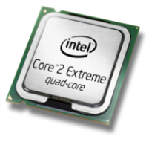
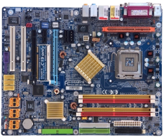
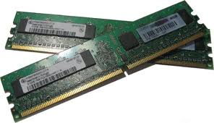
Internal hardware devices
Central Processing Unit (CPU)
 | The CPU is the 'brain' of the computer. It is the device that carries out calculations to complete software instructions.
Motherboard
 | The motherboard is circuit board which is connects to main components of the computer system.
Memory
 | Any data or instructions that are to be processed by the CPU must be placed into main memory.

Slide 3
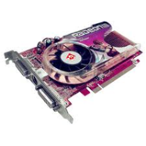
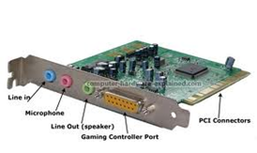
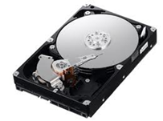
Internal hardware devices
Graphic Video Cards
 | A graphics card is a device that attaches to the motherboard to enable the computer to process and display graphics.
Sound Card
 | A sound card is a device that attaches to the motherboard to enable the computer to input, process, and deliver sound
Internal Hard Disk
 | A hard disk drive is a hardware device that's used to store information like software and files. The capacity of hard drive ranges from GB to Tera Bytes.

Slide 4
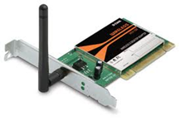
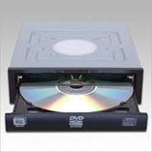
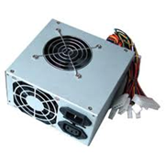
Internal hardware devices
Network Card
 | A network card provides the computer with a network (internet connection) either through wireless signals or a physical cable connection.
Optical Disk Drive
 | The optical disk drive (CD/DVD/Blu-Ray) allows for optical disks to run on the computer. Also some optical disk drives are able to write “burn” data onto discs.
Power Supply
 | The power supply is connected to main power sources to give power to the computer system. The power supply connects to all the main components of the computer system including the motherboard, hard drive, optical drives etc.

Slide 5
Computer Software
What is Software?
Software is a collection of instructions that can be ‘run’ on a computer. These instructions tell the computer what to do. Software is not a physical thing (but it can of course be stored on a physical medium such as a CD-ROM), it is just a bunch of codes. For a computer system to be useful it has to consist of both hardware and software.

Slide 6
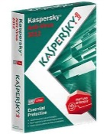
Applications Software and System Software
Application Software
Examples Word Processor Spreadsheet Databases | Application software are designed to allow users to complete specific tasks. This may be to: Write a letter/Present information Browse the internet Manipulate data in a spreadsheet or database Manipulate graphics, sound or video.
System Software
Examples Operating Systems Device Drivers Utilities (antivirus) | System software are normally involved in the running of the computer: Operating systems to provide a user interface Device drivers which allow hardware components to work. Utility software which maintain the computer performance.

Slide 7
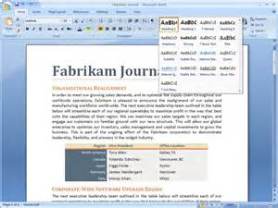
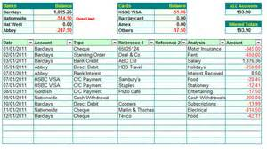
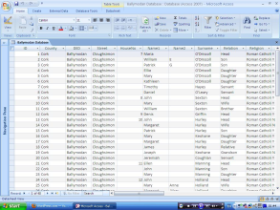
Application Software Examples
Word Processing | Spreadsheet | Database
Used to prepare reports, school essays etc. | Use to create to organise and manipulate numeric data. | Database is used to insert and organise data using fields and records.
Create New or edit existing text documents. Formatting tools Create font styles Importing tables/images Spell Check Copy/Paste Find/Replace Page layout | Use of various formulas to carry out set tasks: Sum, Max, Min, Average Count, CountA CountIf & SumIF Lookups IF and Nested Ifs Apply various formatting to cells/ Create graphs (Ba/Pie charts) | Create a table so that records can be inserted. Run queries using search criteria to find specific data. Create reports including labels from the search criteria.

Slide 8
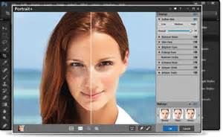
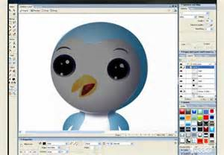
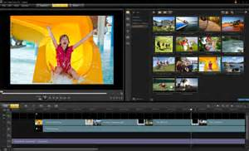
Application Software Examples
Photo Editing | Graphics Manipulation | Video Editing
Used to edit digital images to either touch up or to apply various formatting techniques. | Used to create and edit bitmap and vector graphics. | Used to edit and format video using various tools and techniques.
Contrast/Brightness Use of layers Filter tools Lighting effects Liquify (change features of a face) Brush tools Clone/Stamp tool | Pixels in bitmap images can be changed to produce a different image. Vector images use: Lines Curves Text | Split and Trim videos Create split screens Rearranging order of clips. Transitions between clips (Fade) Inserting Audio Applying filters and using video enhancement techniques

Slide 9
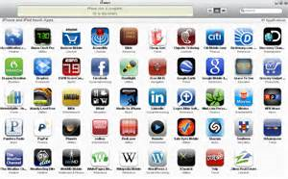
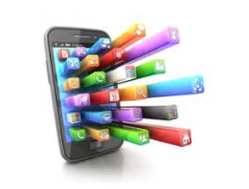
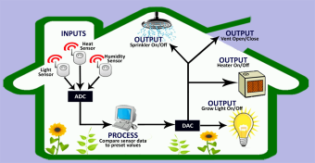
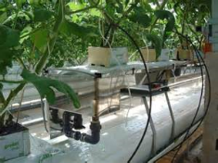
Application Software Examples
Apps (Phone Applications) | Measuring and Control Software
Apps are the software which runs on mobile phones. They usually come with the phone or can be downloaded and updated. | Measuring and control software which are responsible for changing physical conditions in an environment.
Games (Angry Birds) Video/Music Streaming (YouTube) Social Media (Facebook, Twitter, Instagram) Communication (Whats App, Viber) Camera (Editing images) GPS (Satellite navigation) Health/ Fitness | Measuring Sensors take readings which are processed by the computer or microprocessor. Control Software By comparing sensor readings to a pre-set level the control software will decide on an output (For example to increase or decrease the heat in a green house.

Slide 10
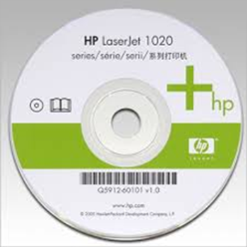
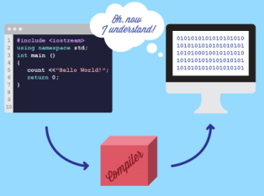
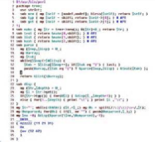
System Software Examples
Operating Systems
Manages computers functions including hardware devices (input/output). Also provides users with a GUI interface
Device Drivers
Allows hardware devices to run on the computer including printers, sound, graphics and network cards.
System
Software
Utilities
Help to manage and maintain computer resources and performance by running specific tasks.
Compiler
Translates a program written
In a specific language which
Can be understood by the
computer.
Linkers
Combines object files
produced by a complier into a
A single program.

